Slide 1
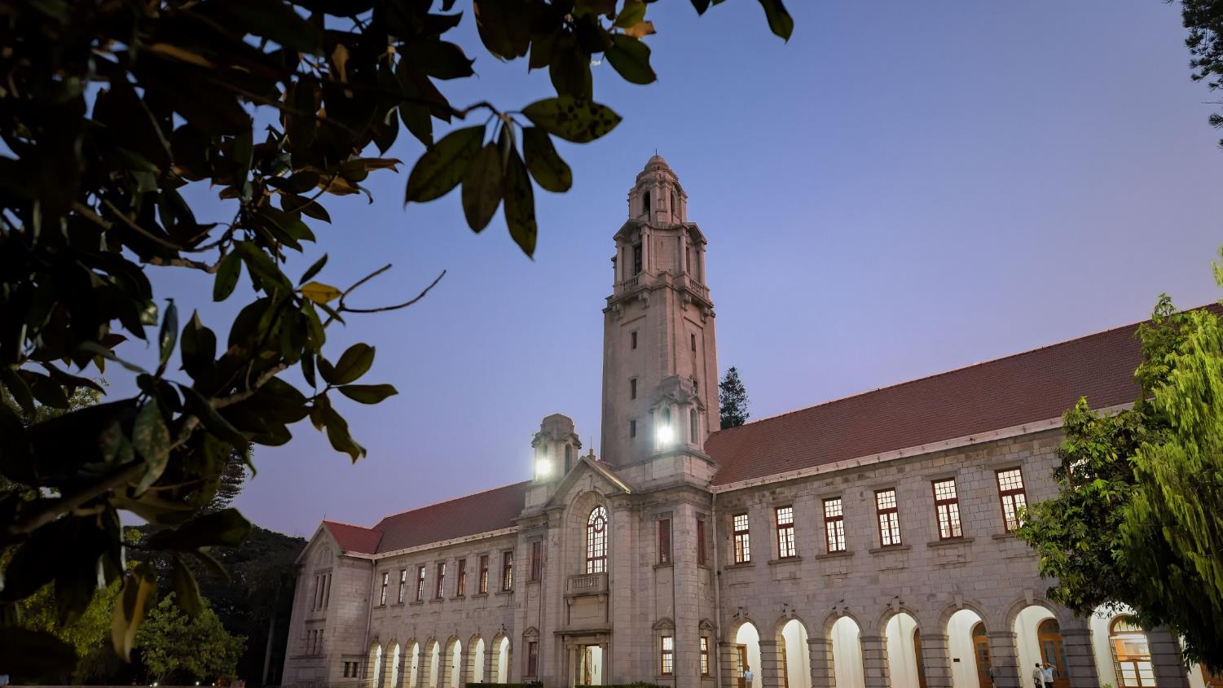

Title of your presentation
Your Team Members
Presenter Name
Indian Institute of Science

Slide 2
Naive Approach
Naive Approach based on understanding to enhance colour images :
Reasoning :
V contains brightness information (Illumination)
Histogram of V shows image has low dynamic range
Improve it by performing CLAHE on V after that Overcome Dark spots using Bilateral filter on V .
Tuning Parameter : Results :
Observed Low Light Enhancement
Some of the darker patches still remain dark
Color Constancy is maintained
CLAHE Clip Limit
CLAHE Window Size
Bilateral spatial sigma
Bilateral color sigma

Slide 3
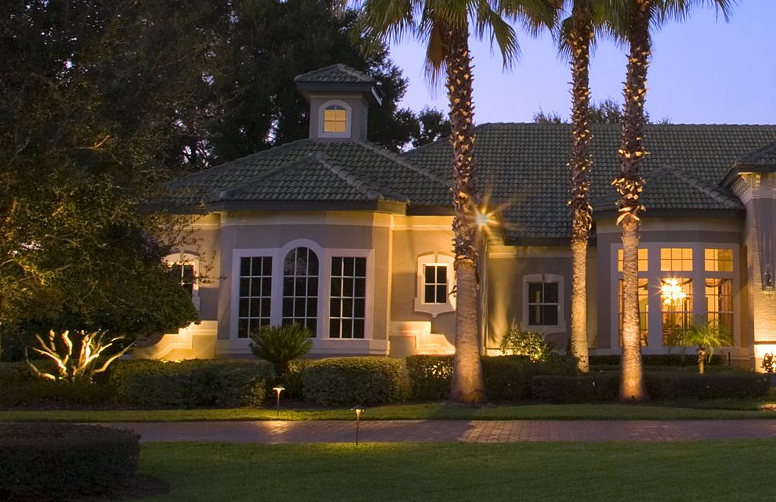
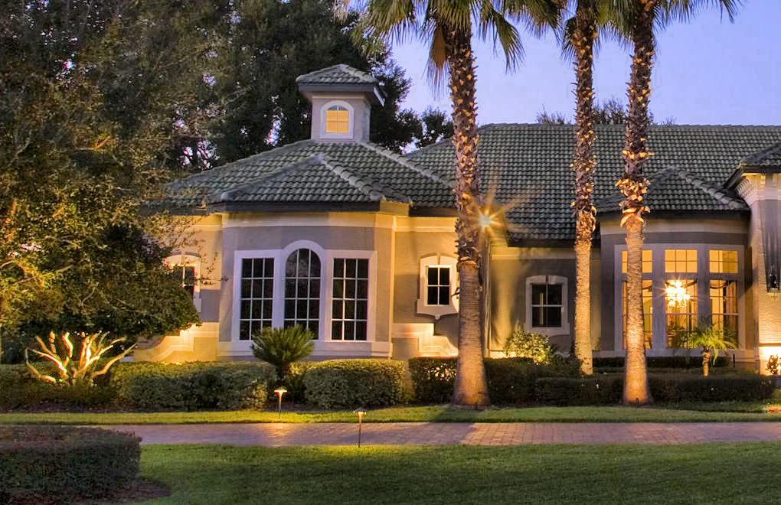
Results Of Naive Approach
Original Image After Naive approach

Slide 4
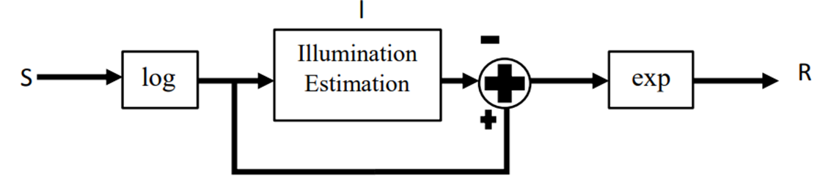
Single Scale Retinex Algorithm (SSR)
SSR Retinex equation as follows :
S – original image pixel R – Reflectance L – illuminance F – Gaussian Kernel
Flowchart :
Reasoning :
Separate Illumination from Intensity using a Gaussian Kernel
Intensity Information without Illumination is ideally stored in Reflectance
Reflectance = log(Intensity) - log(Intensity*Gaussian)
Save Reflectance

Slide 5
Results of SSR
Observed low light enhancement
Darker Patches from the naive approach are lightened
Colour Constancy is not maintained & Greying occurs

Slide 6
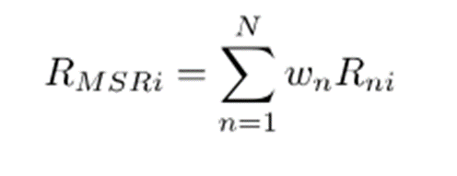
Multi Scale Retinex (MSR)
To achieve good dynamic range compression and good color rendition we will use MSR
Mathematical expression for MSR :
Reasoning :
Perform Single Scale for multiple sigma's.
Take weighted average of the res
Parameters :
N = 3 (Only three sigma values)
Sigma values - 15 , 160 , 210
Wn = 1/3 (assigned equal weights)
§
§

Slide 7
Thank you

